Slide 1
Timotius Alvin (26414052) Daniswara Kusuma (26415128) Antonio Chandra (26415171) Amanda Tanari (26415180)

Slide 2
Informatika UKP Chat
Python

Slide 3

PYGAME

Slide 4
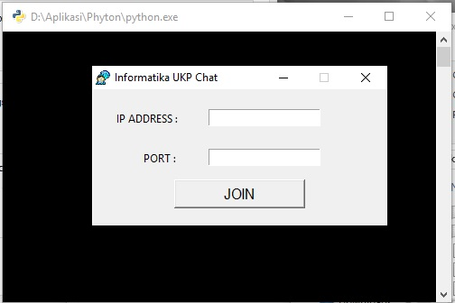

Slide 5
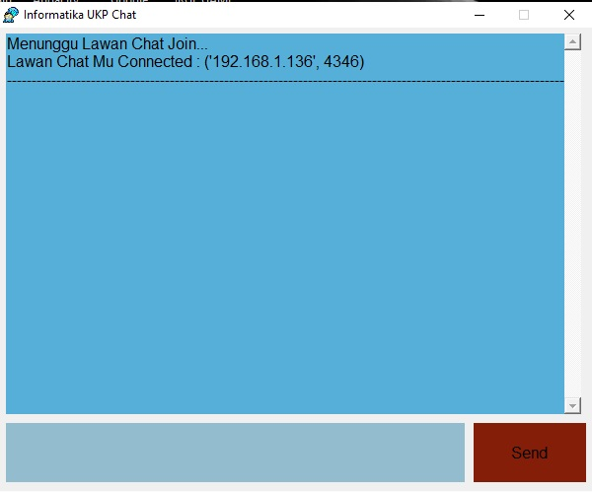
INTERFACE

Slide 6
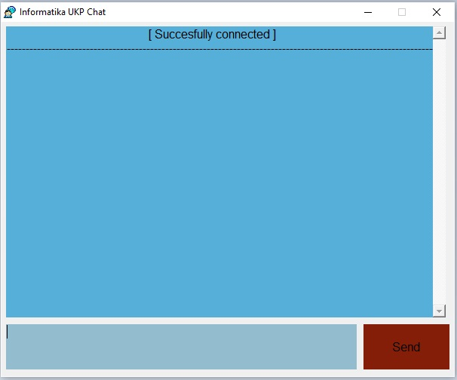
INTERFACE

Slide 7
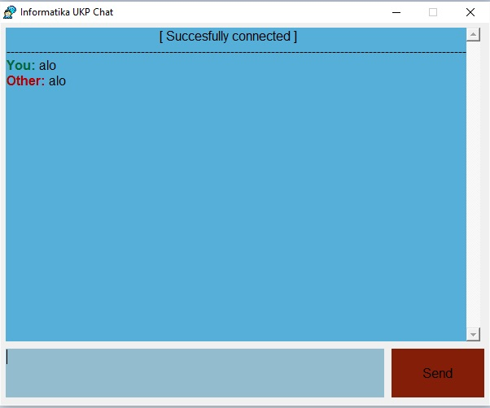
INTERFACE

Slide 8
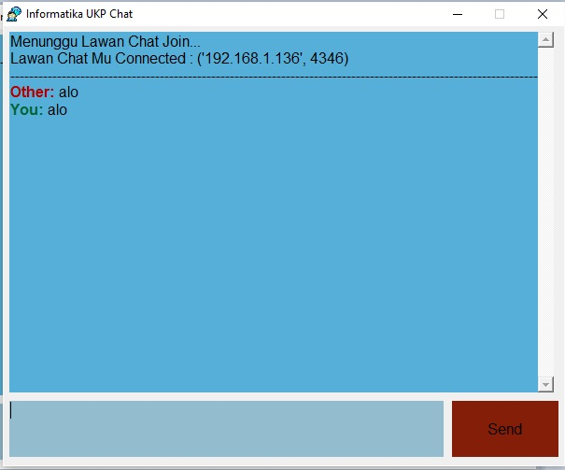
INTERFACE

